Slide 1
Chapter Topics
Comparing Two Independent Samples:
Z Test for the Difference in Two Means
t Test for Difference in Two Means
F Test for Difference in two Variances
Comparing Two Related Samples:
t Tests for the Mean Difference
Wilcoxon Rank-Sum Test:
Difference in Two Medians

Slide 2
Independent Samples
Different Data Sources:
  Unrelated
  Independent
Sample selected from one population has no effect or bearing on the sample selected from the other population.
Use Difference Between the 2 Sample
Means

Slide 3
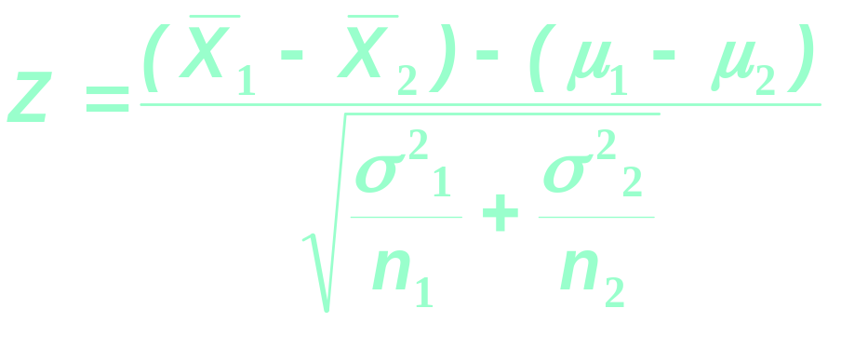
Z Test for Differences in Two Means (Variances Known)
Assumptions:
  Samples are Randomly and Independently
  drawn
  Data Collected are Numerical
  Population Variances Are Known
  Samples drawn are Large
Test Statistic:

Slide 4
t Test for Differences in Two Means (Variances Unknown)
Assumptions:
  Both Populations Are Normally Distributed
  Or, If Not Normal, Can Be Approximated by
  Normal Distribution
  Samples are Randomly and Independently
  drawn
  Population Variances Are Unknown But
  Assumed Equal

Slide 5

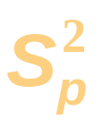
Developing the Pooled-Variance t Test
Compute the Test Statistic:
_
_
(
)
(
)
X
−
X
−
μ
−
μ
t
=
1
2
1
2
Hypothesized Difference
n₁
n₂
df
=
n
+
n
−
2
1
2
(
)
(
)
n
−
1
⋅
2
+
⋅
2
S
n
−
1
S
2
1
1
2
2
S
=
(
)
(
)
P
n
−
1
+
n
−
1
1
2

Slide 6
Pooled-Variance t Test: Example
You’re a financial analyst for Charles Schwab. Is there a difference in dividend yield between stocks listed on the NYSE & NASDAQ? You collect the following data:
NYSE NASDAQ
Number 21 25
Mean 3.27 2.53
Std Dev 1.30 1.16
Assuming equal variances, is
there a difference in average
yield (α = 0.05)?
© 1984-1994 T/Maker Co.

Slide 7

Solution
H₀: μ₁ - μ₂ = 0 (μ₁ = μ₂)
H₁: μ₁ - μ₂ ≠ 0 (μ₁ ≠ μ₂)
α = 0.05
df = 21 + 25 - 2 = 44
Critical Value(s):
Test Statistic:
Decision:
Conclusion:
3
.
27
−
2
.
53
t
=
=
2
.
03
1
.
510
21
25
Reject H
Reject H
Reject at α = 0.05
0
0
.025
.025
There is evidence of a difference in means.
-2.0154
0
2.0154
t

Slide 8

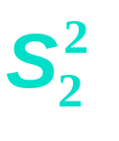
F Test for Differences in Two Variances
The F test Statistic:
= Variance of Sample 1
F =
n₁ - 1 = degrees of freedom
= Variance of Sample 2
n₂ - 1 = degrees of freedom
0
F

Slide 9
F Test for the Difference in Two Population Variances
Tests for Differences in 2 Independent Population Variances
Parametric Test Procedure
Assumptions
  Both Populations Are Normally Distributed
    Test Is Not Robust to Violations

Slide 10
F Test for the Difference in Two Population Variances
Reject H₀
Hypotheses
  H₀: σ₁² = σ₂²
  H₁: σ₁² ≠ σ₂²
Test Statistic
  F = S₁² /S₂²
  Two Sets of Degrees of Freedom
    df₁ = n₁ - 1; df₂ = n₂ - 1
  Critical Values: F_{L( )} and F_{U( )}
  F_{L} = 1/F_{U}* (*degrees of freedom switched)
Reject H₀
Do Not
Reject
α/2
α/2
0
F_{L}
F_{U}
F
n₁ -1, n₂ -1
n₁ -1 , n₂ -1

Slide 11
F Test: An Example
Assume you are a financial analyst for Charles Schwab. You want to compare dividend yields between stocks listed on the NYSE & NASDAQ. You collect the following data:
NYSE NASDAQ
Number 21 25
Mean 3.27 2.53
Std Dev 1.30 1.16
Is there a difference in the variances between the NYSE & NASDAQ at the 0.05 level?
© 1984-1994 T/Maker Co.

Slide 12
F Test: Example Solution
H₀: σ₁² = σ₂²
H₁: σ₁² ≠ σ₂²
α = .05
df₁ = 20 df₂ = 24
Critical Value(s):
Test Statistic:
Decision:
Conclusion:
1
2
.
30
F
=
=
=
1
.
25
1
2
.
16
Reject
Reject
Do not reject at α = 0.05
.025
.025
There is no evidence of a difference in variances.
0
0.415
2.33
F

Slide 13
Comparing Two Related Samples: t Test for Mean Difference
Tests Means of 2 Related Populations
  Paired or Matched
  Repeated Measures (Before/After)
  Use Difference Between Pairs
Eliminates Variation Among Subjects
Assumptions
  Both Population Are Normally Distributed
  Or, if Not Normal, use large samples
  D_{n} = X_{1n} - X_{2n}

Slide 14

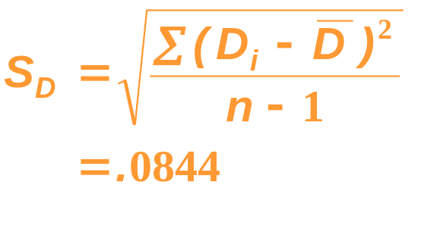
Paired Sample t Test: Example
Assume you work in the finance department. Is the new financial package faster (0.05 level)? You collect the following data entry times:
User Current Leader (1) New Software (2) Difference D_{i}
C.B. 9.98 Seconds 9.88 Seconds .10
T.F. 9.88 9.86 .02
M.H. 9.84 9.75 .09
R.K. 9.99 9.80 .19
M.O. 9.94 9.87 .07
D.S. 9.84 9.84 .00
S.S. 9.86 9.87 - .01
C.T. 10.12 9.86 .26
K.T. 9.90 9.83 .07
S.Z. 9.91 9.86 .05
Σ
D_{i}
D =
=.084
n

Slide 15
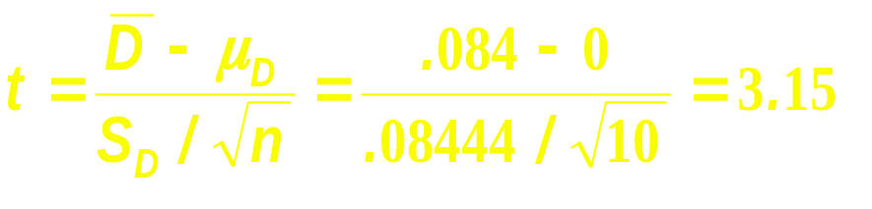
Paired Sample t Test: Example Solution
Is the new financial package faster (0.05 level)?
H₀: μ_{D} ≤ 0
H₁: μ_{D} > 0
Reject
α =.05
α =.05
D =
.084
1.8331
Critical Value=1.8331 df = n - 1 = 9
Decision: Reject H₀
t Stat. in the rejection zone.
Test Statistic
Conclusion: The new software package is faster.

